Slide 1


What’s New on the Microsoft Web Stack
ANTHONY CHU
anthony@anthonychu.ca @nthonyChu

Slide 2
Agenda
ASP.NET
Visual Studio
Windows Azure

Slide 3


About Me
www
Web – ASP.NET, JavaScript, *.js
Mobile – Windows Phone
Lead Developer & Architect at 3AG Systems Inc

Slide 4
Web Development in 2004
Desktop browsers
HTML
Postbacks
SOAP web services
IT had full control of PCs, OS, browsers

Slide 5









Web Development in 2014
Desktops, laptops, tablets, phones
HTML, CSS, JavaScript
Single Page Apps
RESTful services
Real-time
BYOD
Cloud
ASP.NET

Slide 6
What’s new in ASP.NET

Slide 7
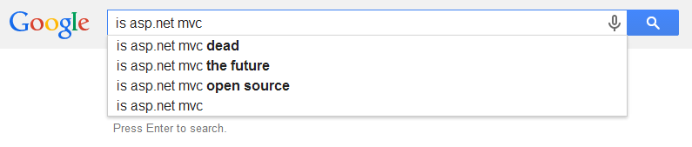
ASP.NET Today

Slide 8
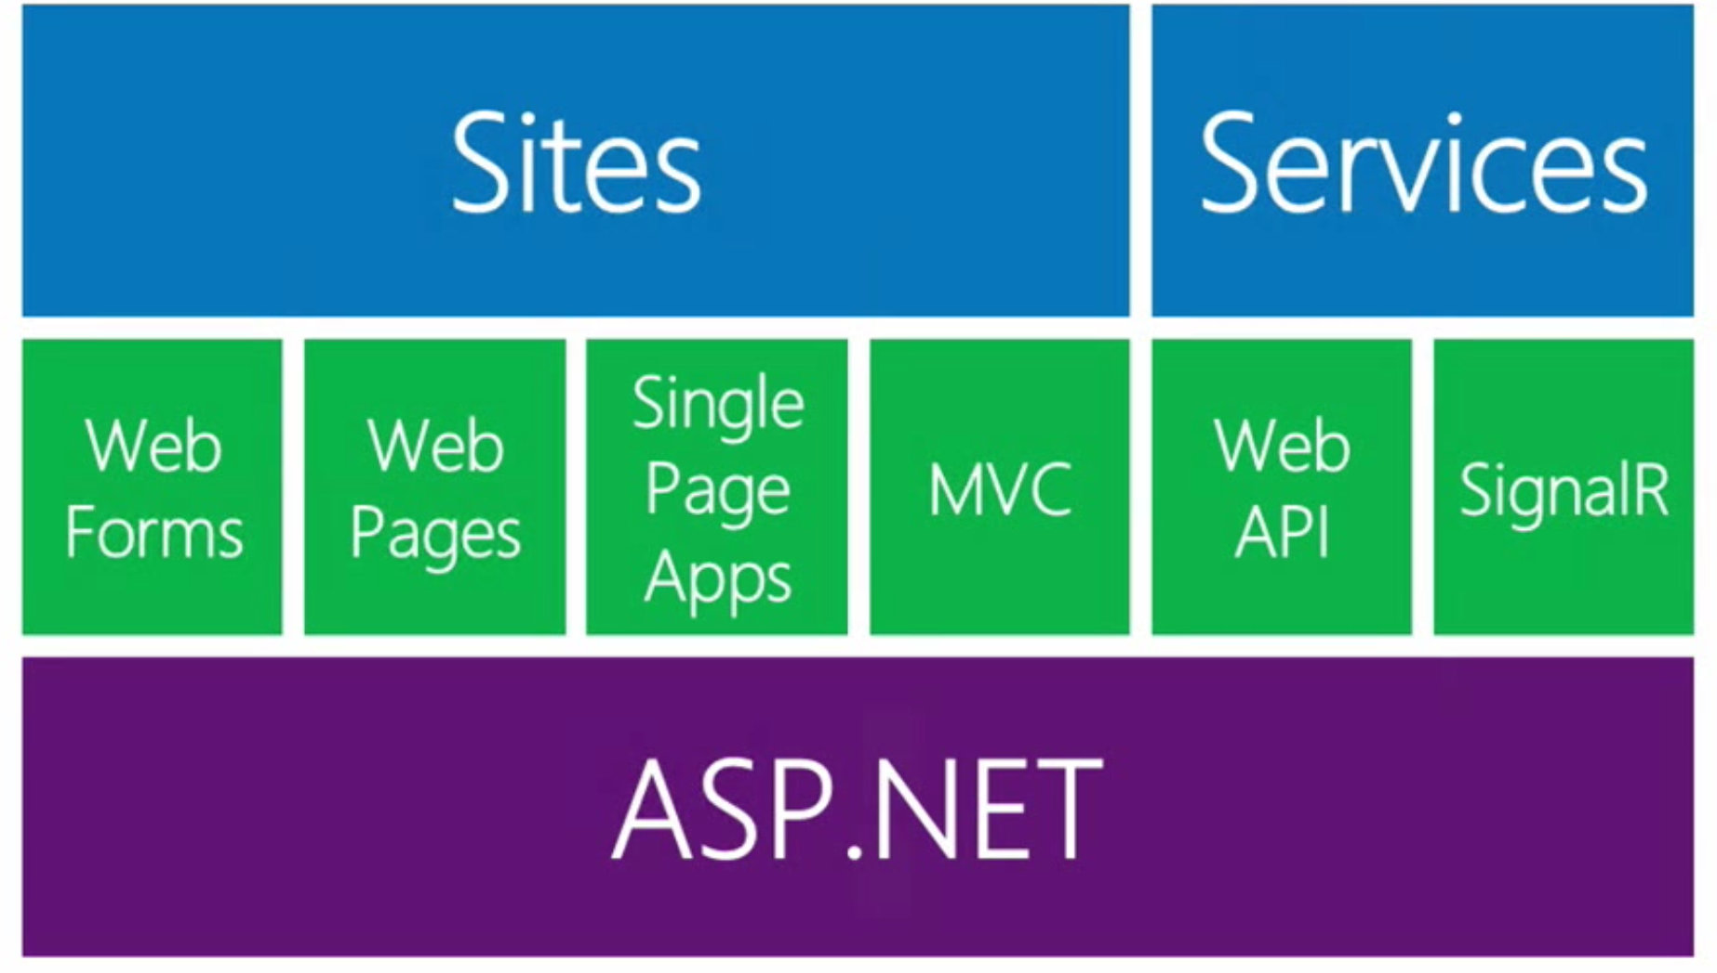
One ASP.NET

Slide 9
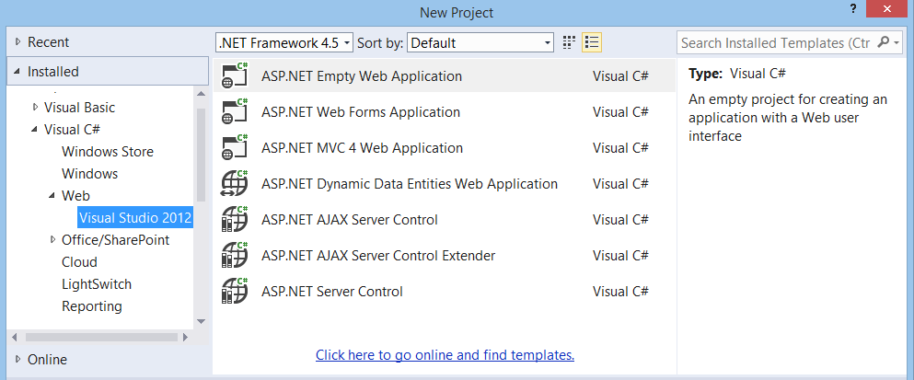
Visual Studio 2012

Slide 10
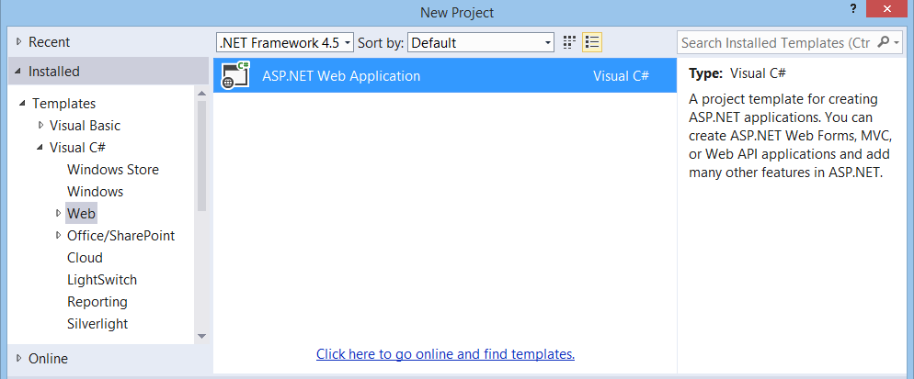
Visual Studio 2013

Slide 11
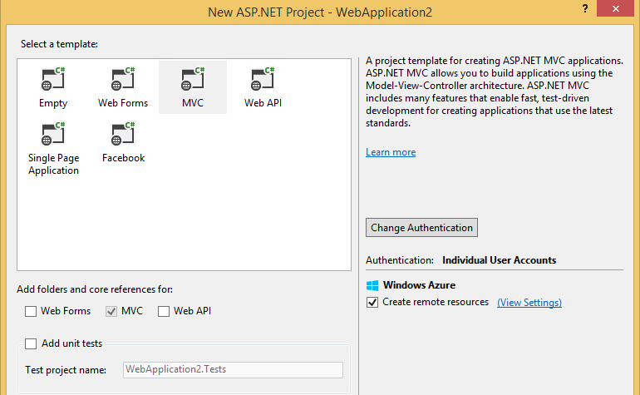
Visual Studio 2013

Slide 12

Open Source
ASP.NET MVC
ASP.NET Web API
ASP.NET Web Pages (Razor)
Entity Framework
Web Essentials
Third Party Frameworks

Slide 13
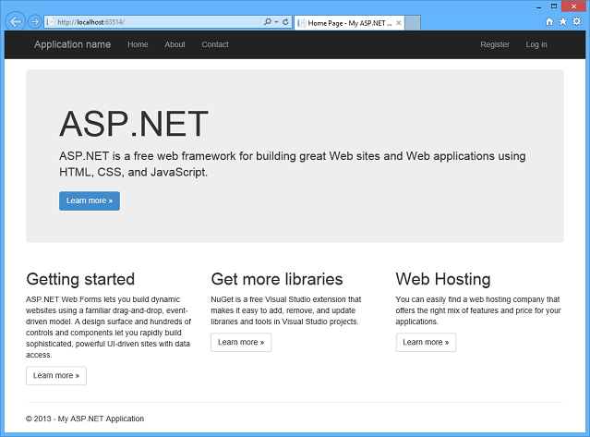
Bootstrap 3 Templates

Slide 14
OWIN
Web Application
Framework (Middleware)
System.Web / HttpListener
IIS / OwinHost / Other
Open Web Interface for .NET
Decouples web apps from IIS
Katana – Microsoft implementation
SignalR and Web API on OWIN

Slide 15
ASP.NET Identity
All frameworks – Web Forms, MVC, Web API, Web Pages, SignalR
OWIN Middleware
Entity Framework implementation – Code First
Customizable, extensible
Claims aware
External login integration – Facebook, Google, Twitter, Microsoft, AD
ASP.NET Identity 2.0 coming

Slide 16
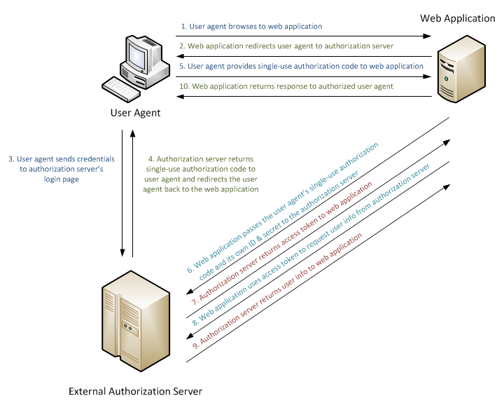
ASP.NET Identity

Slide 17
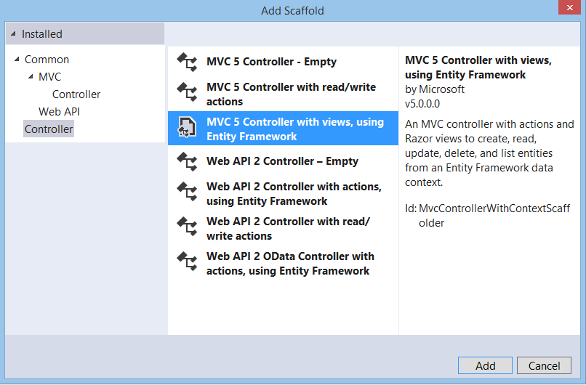
ASP.NET MVC 5 & 5.1
Authentication filters
Attribute routing
Improved scaffolding
SignalR 2
Razor 3

Slide 18
ASP.NET Web API 2 & 2.1
OWIN
Attribute Routing
OAuth 2
OData improvements
CORS support
[RoutePrefix("api/books")]
public class BooksController : ApiController
{
// GET /api/authors/1/books
[Route("~/api/authors/{authorId:int}/books")]
public IEnumerable<Book> GetByAuthor(int authorId)
{ ... }
// ...
}

Slide 19
Attribute Routing
routes.MapRoute(
name: "Books",
url: "api/authors/{id}/books",
defaults: new
{
controller = "Books",
action = "GetByAuthor"
}
);
public class BooksController : ApiController
{
[Route("api/authors/{authorId:int}/books")]
public IEnumerable<Book> GetByAuthor(int authorId)
{ ... }
// ...
}

Slide 20
REST vs SOAP
 | REST | SOAP
Standardized | No | Yes (WS-*)
Transport | HTTP | HTTP, FTP, Pipes, MSMQ,…
Data Format | Any | XML
Reach | Excellent | Good
Development Tools | Basic | Good
Flexibility | Flexible | Rigid
Scalability | Excellent | Reasonable
Security | OAuth, Cookies, over HTTPS | WS-Security
Operations | Stateless | Often Stateful
Good For | JavaScript, Devices | Server to Server

Slide 21
Entity Framework async/await
var users = db.Users.ToList();
var user = db.Users.Single(u => u.Id == userId);
var users = await db.Users.ToListAsync();
var user = await db.Users.SingleAsync(u => u.Id == userId);

Slide 22
ASP.NET MVC async/await
public ActionResult Index()
{
var users = db.Users.ToList();
return View(users);
}
public async Task<ActionResult> Index()
{
var users = await db.Users.ToListAsync();
return View(users);
}

Slide 23
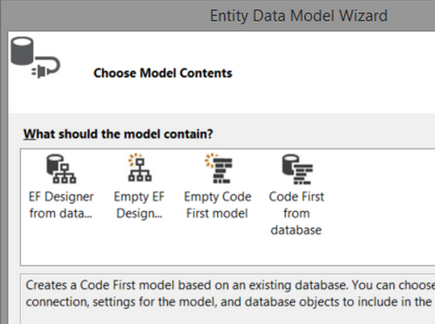
Entity Framework 6
Task and async/await support
Custom Code First conventions
Code First Stored Proc Mappings
Connection Resiliency
Query interception and logging

Slide 24
What’s new in Visual Studio

Slide 25
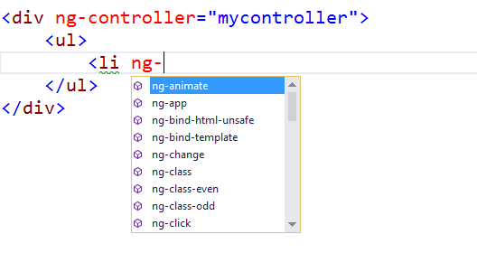
New HTML/Razor editor

Slide 26
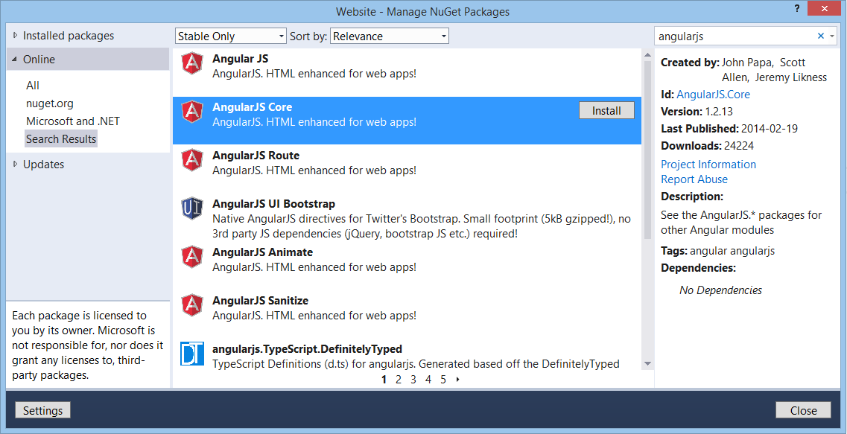
NuGet

Slide 27
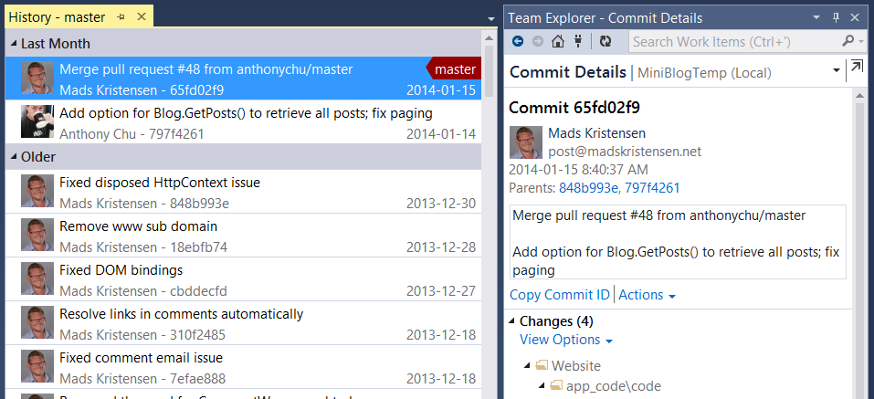
Git Support

Slide 28
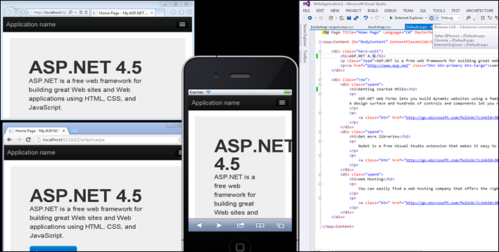
Browser Link

Slide 29

Web Essentials 2013
CSS editor enhancements
Zen Coding
Browser Link add-ins
F12 Sync
Page Designer/Inspector
Find Unused CSS
TypeScript, CoffeeScript, Markdown preview windows

Slide 30
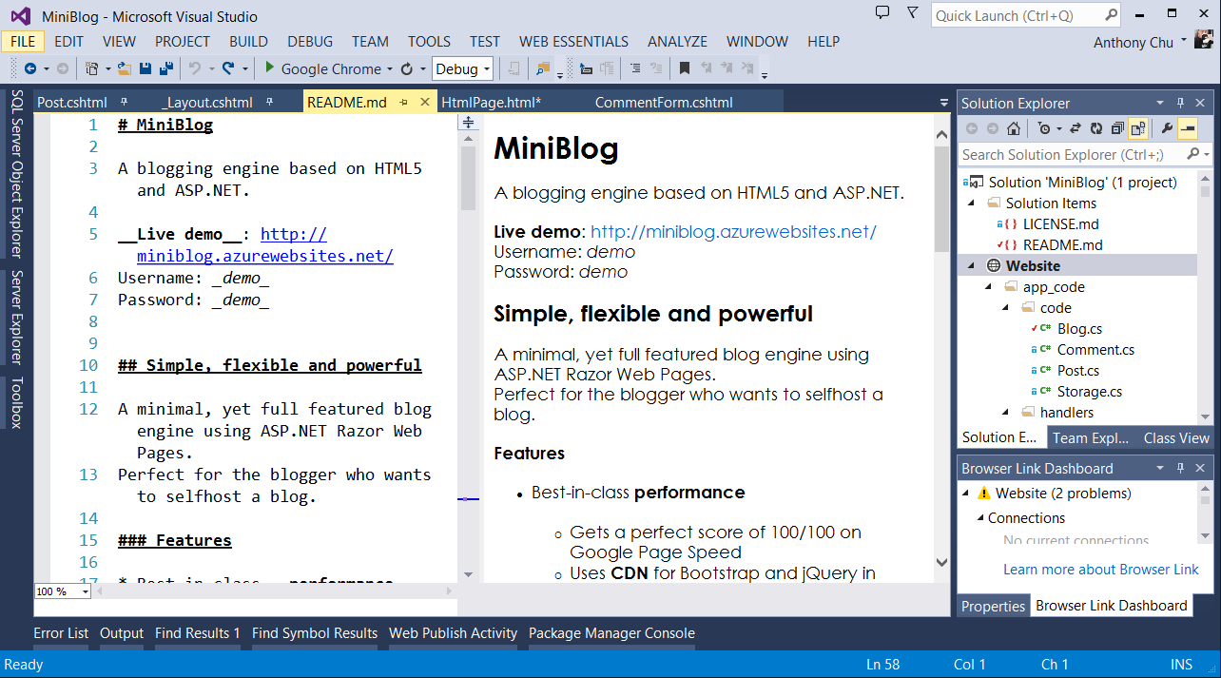
Web Essentials – Preview Window

Slide 31
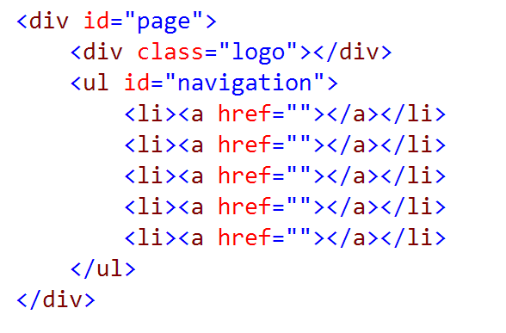
Web Essentials – Zen Coding

Slide 32
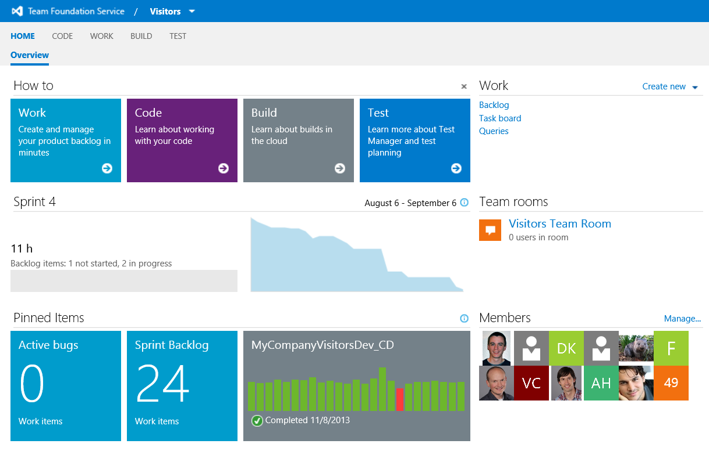
Visual Studio Online
Up to 5 users free
Private TFVC / Git Repos
Project planning
Bug tracking
MSDN Premium
Test plans and execution
Portfolio tracking
Build
Application Insights
Cloud Load Testing

Slide 33
ASP.NET Demo
Visual Studio
Web Essentials
Bootstrap
LESS
Browser Link
ASP.NET Identity
Entity Framework
Web API
AngularJS
SignalR
Glimpse
Azure Deployment

Slide 34
ASP.NET Demo
Event management application
Admin CRUD backend
User accounts plus external (Google) login
Single page app frontend with AngularJS
Realtime updates
Diagnostics
Publish to Azure Web Sites

Slide 35
Windows Azure for Developers

Slide 36
MSDN Benefits
Monthly Credits
Dev/Test
Discounts
VM – 33%
Cloud – 25%
Websites – 40%
HDInsight – 25%
Professional | Premium | Ultimate
$60 | $110 | $160

Slide 37
Virtual Machines
Infrastructure as a Service
Windows
Linux
Oracle
Visual Studio
Extra Small 1 GHz 768 MB | Small 1.6 GHz 1.75 GB | Large 4x 1.6 GHz 7 GB | A7 8x 1.6 GHz 56 GB
$16 | $70 | $282 | $1255

Slide 38
Web Sites
Platform as a Service
ASP.NET, NodeJS, PHP, ASP
Scale up, scale out, auto scale
Staging
Source control deployment
Remote debug, logging, tracing
Visual Studio, IIS Manager, Command line
Free | Shared | Standard - Sm
Free | $10 | $78

Slide 39
SQL Database
Managed infrastructure
Automatic 2 data centre replication
Familiar tools
SQL Server Management Studio
Visual Studio SQL Server Objects Explorer
Azure Portal
PowerShell
REST
1 GB | 150 GB
$10 | $238

Slide 40
Mobile Services
Backend as a service
Dynamic schema tables
Node.js and ASP.NET Web API
Identity
Push notifications
More on May 6 user group
Free | Basic | Standard
Free | $26 | $210

Slide 41
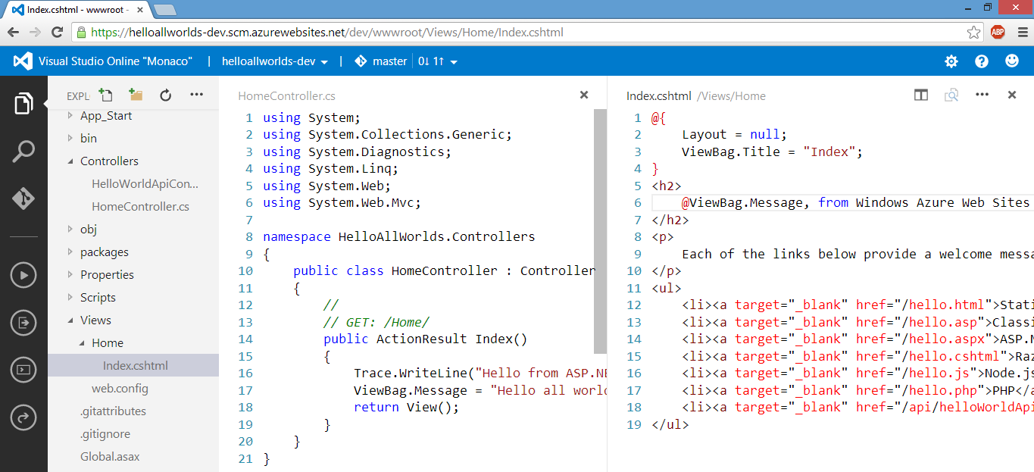
Visual Studio Online (Monaco)

Slide 42
App Services
Data Services
Media Services
Services Bus
Notification Hub
Scheduler
BizTalk Services
Active Directory
Multi-factor Authentication
Storage
HDInsight
Cache
And more!

Slide 43
WindowsAzure Demo
Azure Portal
Visual Studio
Azure Web Sites
ASP.NET, Node, PHP
Diagnostics
Debugging
Scaling
Staging/Production
GitHub integration
VS Online (Monaco)

Slide 44
WindowsAzure Demo
Quick tour of Azure Portal
Deploy ASP.NET/Node/PHP app to Web Sites
Remote debug / stream logs
Web Sites Staging/Production
Visual Studio GitHub integration
Deploy to Web Sites from GitHub
Edit with Visual Studio Online (Monaco)

Slide 45
2014 Roadmap
Updates
Visual Studio 2013
Update 2 in April
Update 3 in summer?
???
Windows Azure
Updates all the time
Upcoming Features
AngularJS
Node.js Tools
TypeScript 1.0
SASS and JSON editors
Even more Azure integration
????

Slide 46
Things to do
Install Visual Studio 2013 and Web Essentials
Sign up for Windows Azure
Get a free Visual Studio (TFS) Online account

Slide 47
Thank you!
Survey
bit.ly/dotnetbc
Chance to win a 1 month Pluralsight subscription
Web anthonychu.ca
Twitter @nthonyChu
Email anthony@anthonychu.ca
GitHub github.com/anthonychu

Slide 48
©2014 Anthony Chu
anthony@anthonychu.ca

